Slide 1
Doing Data Science
Final Case Study
EDA on Attrition
Alonso Salcido

Slide 2
Attrition
No: 81%
Yes: 19%

Slide 3
Over Time
Attrition & Over Time: 57%
No Attrition & Over Time: 24%

Slide 4
Attrition by Department
Sales Department: Highest Attrition Rate by Department
Research & Development Personnel has less percentage of people in the attrition group than in the no attrition group.

Slide 5
Attrition by Job Role
Key Job Roles:
Sales Representatives (High Attrition)
Research Director (Minimal Attrition)
Healthcare Representative (Low Attrition)
Manager (Low Attrition)

Slide 6
Attrition by Marital Status
Single (High)
Divorced (Low)

Slide 7
Attrition by Age
Lower Mean & Median Age than No Attrition Group

Slide 8
Attrition by Distance From Home
Close to Home
No Attrition Group tends to live closer to work

Slide 9
Attrition by Monthly Income
Attrition Group
Lower Mean and Median Monthly Income than No attrition Group

Slide 10
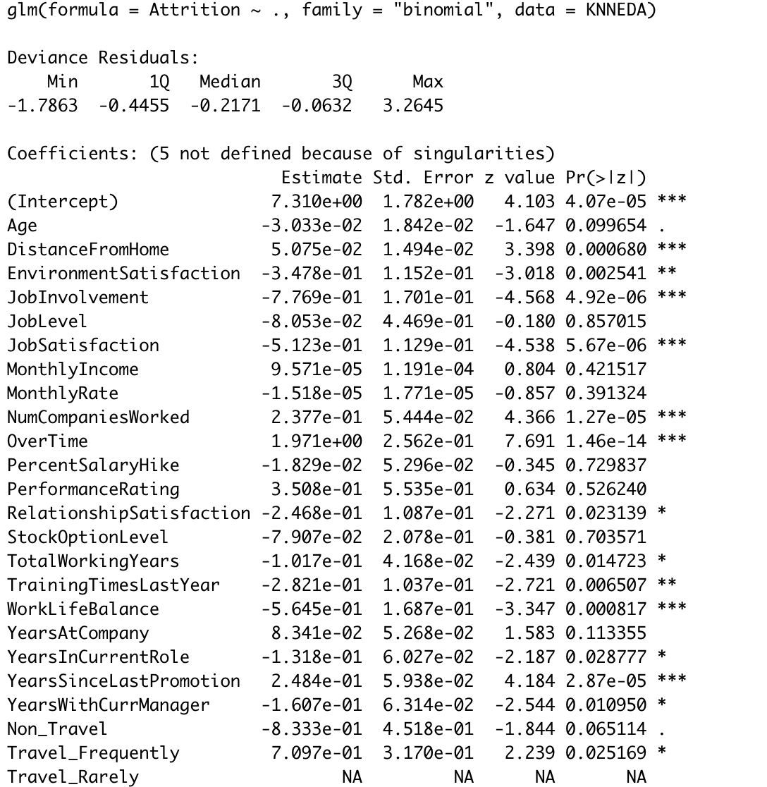
Top 3 Factors of Attrition
Over Time
Job Involvement
Job Satisfaction
Over 40 Factors Analyzed
Generalized Linear Model

Slide 11
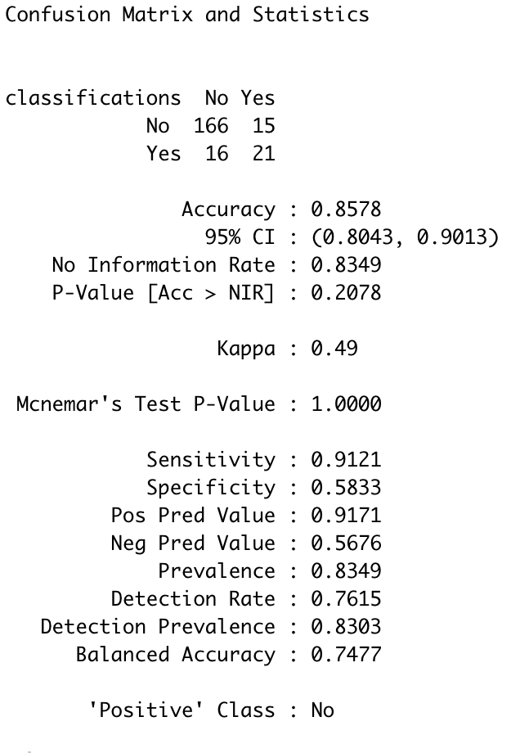
Predict Attrition Naive Bayes
12 Variables Used
86% Accuracy
Extremely High Sensitivity
High Specificity

Slide 12
Interesting Trend
The Lowest category in an ordinal Variable has the highest difference in attrition

